Slide 1
Deep Learning
Architecture ad Dimensions of CNN
Prof. A.S.Gavali
CSMSS,CSCOE,Aurangabad

Slide 2
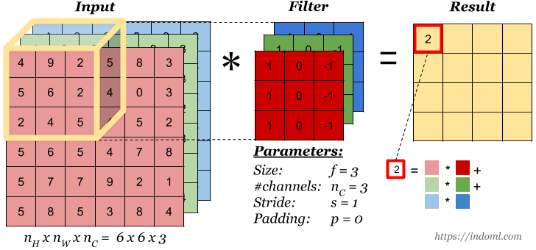
When the input has more than one channels (e.g. an RGB image), the filter should have matching number of channels. To calculate one output cell, perform convolution on each matching channel, then add the result together.
Convolution Operation on Volume

Slide 3
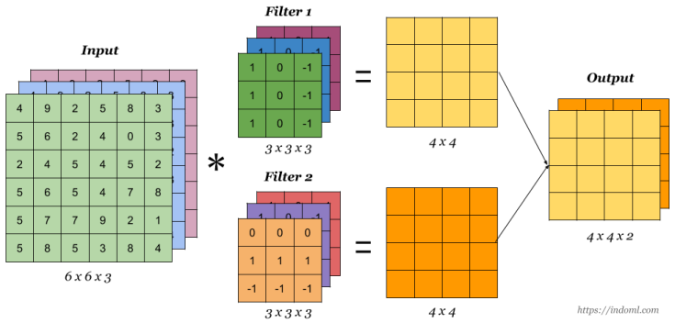
Multiple filters can be used in a convolution layer to detect multiple features. The output of the layer then will have the same number of channels as the number of filters in the layer.
Convolution Operation with Multiple Filters

Slide 4
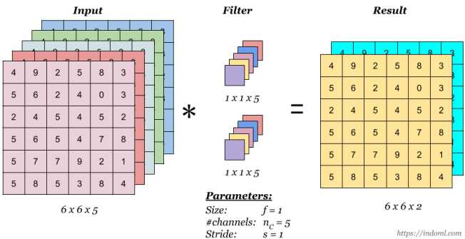
This is convolution with 1 x 1 filter. The effect is to flatten or “merge” channels together, which can save computations later in the network:
1 x 1 Convolution

Slide 5
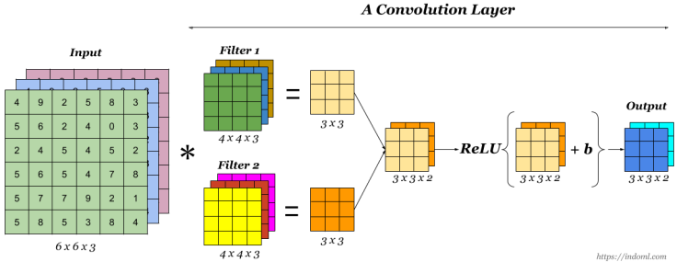
Finally to make up a convolution layer, a bias (ϵ R) is added and an activation function such as ReLU or tanh is applied.
One Convolution Layer

Slide 6
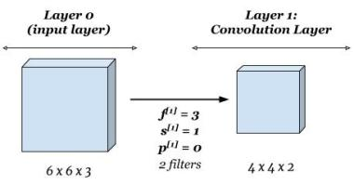
Shorthand Representation

Slide 7
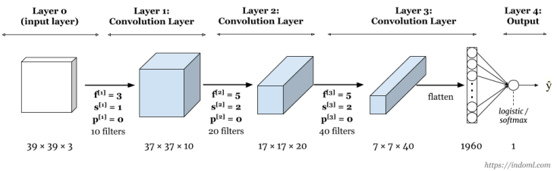
This is a sample network with three convolution layers. At the end of the network, the output of the convolution layer is flattened and is connected to a logistic regression or a softmax output layer.
Sample Complete Network

Slide 8
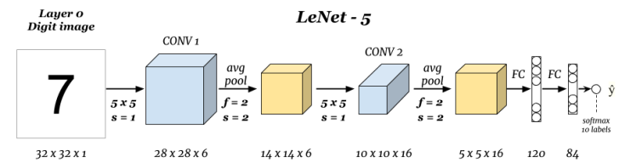
Well Known Architectures
1.Classic Network: LeNet – 5
Number of parameters: ~ 60 thousands.

Slide 9
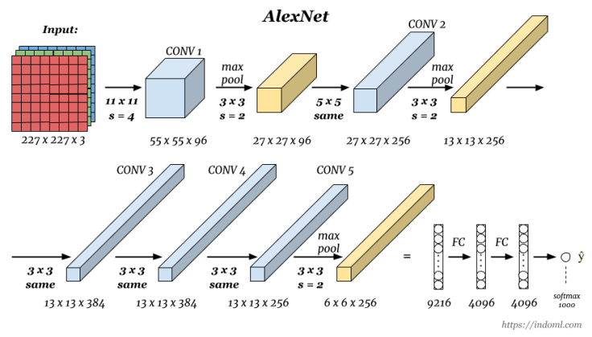
Well Known Architectures
2. Classic Network: AlexNet
Number of parameters: ~ 60 thousands.

Slide 10
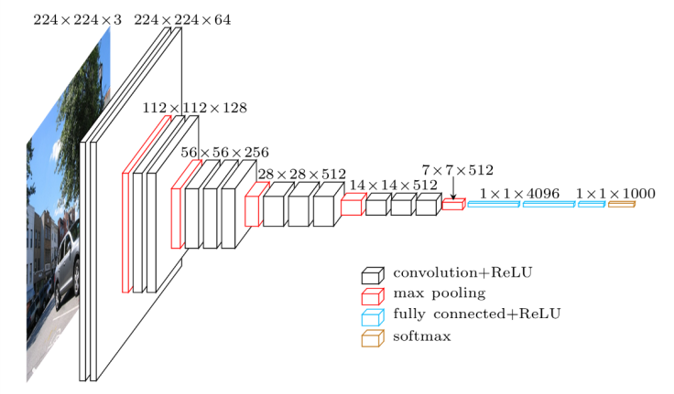
Well Known Architectures
2. Classic Network: VGG-16
Number of parameters: ~ 138 millions.
The strength is in the simplicity: the dimension is halved and the depth is increased on every step (or stack of layers)

